Slide 1

Do more expensive restaurant have better health inspections scores?
Group 5
Weylin Lam
Delvin Milligan
Nancy Mathur
Christian Thomson

Slide 2
Do more expensive restaurant have (better health inspections scores)?

Slide 3
Who cares?
We chose this topic because
We wanted to know if price influences the outcome of an (inspection / better rating)
What we found to be true is
Notes:
We believed that restaurants that cost more had better health inspection scores
We all deiced that the biggest thing we had in common was food.
Portland is a foody town
We like to eat
Perception of higher cost = better experience

Slide 4
Why we believe our outcome
This is where a data frame of our imported data will be housed.

Slide 5
What didn’t we care about
Show code about columns we left out?
jupyter notebook reference
Show code about what we brought in?
jupyter notebook reference
# Be able to link this data to our code we might want to have some indexing where it is located for quick identification. We could use a markdown item number in Jupyter for a quick reference?

Slide 6
What was the first relationships we looked at?
Insert graphs

Slide 7
Eureka!
insights you had while exploring the data that you didn't anticipate

Slide 8
Did think that would happen
any problems that arose after exploring the data, and how you resolved them

Slide 9
interesting figures
Find a couple of things in Jupyter that are worth talking about
jupyter notebook reference

Slide 10
Started to read the documentation
Tried to understand what information we got back
Changed our scope once we looked at the data in more depth

Slide 11
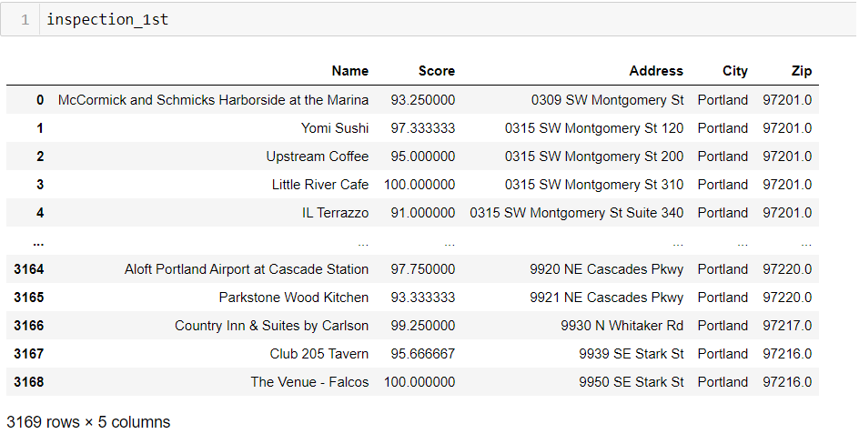
We used a phone and got some info from the County

Slide 12
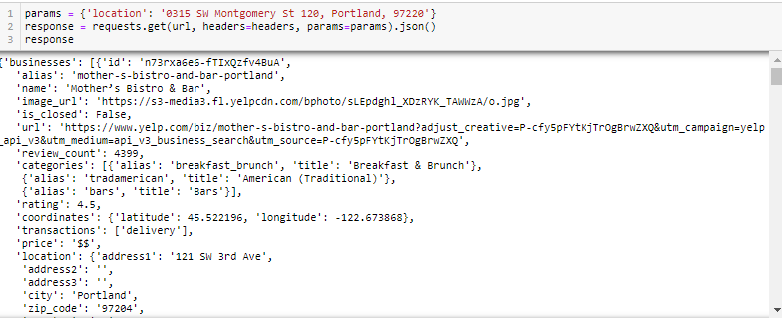
We changed direction

Slide 13
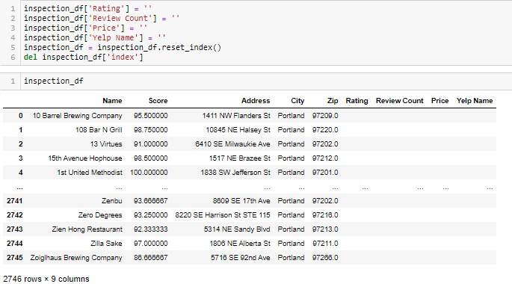
We needed more columns

Slide 14

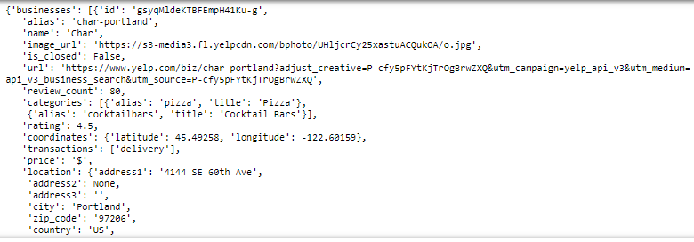
We used

Slide 15
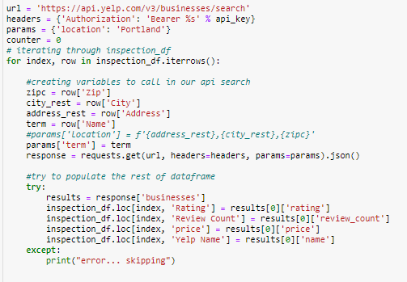
We asked the world for results

Slide 16
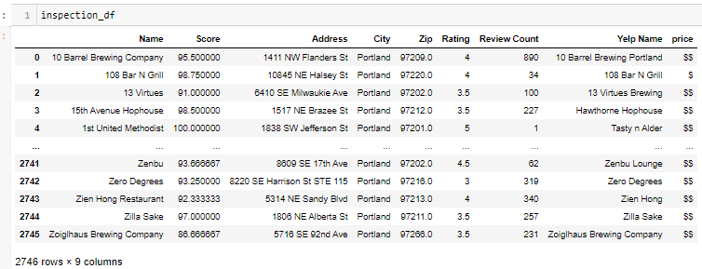
We added some data to columns

Slide 17
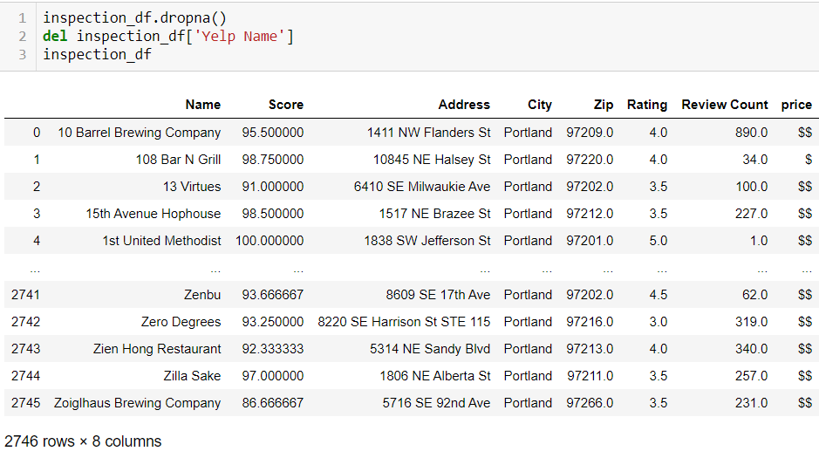
We got rid of rows with not enough info our Data is clean!

Slide 19
When it was time to analyze the data
We found …
Try to point to a part of our jupyter notebook
jupyter notebook reference
We didn’t expect to find …
Try to point to a part of our jupyter notebook
jupyter notebook reference

Slide 20
Why we are right if we are?
Our assumption was the more expensive a restaurant is the better the health score.
What we found was (X) of business with an expensive rating scored (X%) on a health inspection
We found that (X) business with less expensive rating scored (X%) on a health inspection
We found that (X) business with an average expense rate scored (X%) on a health inspection

Slide 21
Memories
Things that went really well
Things that well
Things that did what they did
Things that became a pain
Things that sucked

Slide 22
What do we wish we could have looked at
If we had more time
A
B
C
If we had more recourse
A
B
C

Slide 23
Thank you for your time
Questions?

